Slide 1
Cortana Intelligence Suite
Transform data into intelligent action

Slide 2
Azure PPE Technical Training
Module 1 – Introducing Cortana Intelligence Suite | Day 1
Module 2 – Information Management
Module 3 – Big Data Stores | Day 2
Module 4 – Machine Learning and Analytics Part 1
Module 5 – Machine Learning and Analytics Part 2 | Day 3
Module 6 – Cognitive Services
Module 7 – Power BI and Power BI Embedded | Day 4
Audience: Architects, Data Scientists and Developers

Slide 3



Big Data Stores
Information Management
Big Data Stores
Data Sources
Data Factory
Data Lake Store
Apps
Data Catalog
SQL Data
Warehouse
Event Hubs
Sensors and devices
Data

Slide 4



A hyper-scale repository for big data analytics workloads
Big Data Stores
Devices
Social
ADL Analytics
Data Lake Store
LOB Applications
Video
HDInsight
ADL Store
SQL Data
Warehouse
R
Web
Sensors
Spark
Relational
Clickstream
Machine Learning
A Hadoop Distributed File System for the cloud
No fixed limits on file size
No fixed limits on account size
Unstructured and structured data in their native format
Massive throughput to increase analytic performance
High durability, availability, and reliability
Azure Active Directory access control

Slide 5

Introducing Azure Data Lake Store
A hyper-scale repository for big data analytics workloads
Store ANY DATA in its native format
HADOOP FILE SYSTEM (HDFS) for the cloud
ENTERPRISE GRADE
No limits to SCALE
Optimized for analytic workload PERFORMANCE

Slide 6


Any data
Devices
Video
Unstructured
Semi-structured
Structured
Clickstream
Web
Social
Sensors
Relational
LOB applications

Slide 7




HDFS for the cloud
Built from the ground up as a Hadoop file system
Support for file/folder objects and operations
Integration with HDInsight, Hortonworks, and Cloudera
Accessible to all HDFS-compliant projects
Spark | Storm | Flume Sqoop | Kafka | R | and more
ADL Store
HDInsight

Slide 8



Durable and highly available
Automatically replicates your data
Three copies within a single region
Highly available

Slide 9
Unlimited storage
PB
GB
Unlimited account sizes
Individual file sizes from gigabytes to petabytes
No limits to scale
TB
TB
PB

Slide 10
Optimized for analytics workload performance
Built for running large analytics systems that require massive throughput
Optimized for parallel computation over petabytes of data
Automatically optimizes for any throughput

Slide 11
Manage and secure your data
Auditing
Access control
Encryption at rest
Audit logs for all operations*
Audit logs that can be analyzed with ADL U-SQL Scripts*
POSIX-compliant access control lists (ACLs) on files and folders*
Integrated with Azure Active Directory
Transparent server-side encryption*
Azure-managed (Azure Key Vault) and customer-managed keys*
*Features arriving by GA

Slide 12





Azure Data Lake Store – Ingress
Data can be ingested into Azure Data Lake Store from a variety of sources
SQL
Apache Flume
Azure SQL DB
Server logs
Built-in copy service
Azure SQL DW
Azure Data Factory
Azure Storage blobs
Table Storage
Apache Sqoop
.NET SDK
JavaScript CLI
Azure portal
Azure PowerShell
ADL Store
Azure Table
On-premises databases
Custom programs
Azure Event Hub

Slide 13
Azure Data Lake Store – Egress
Data can be exported from Azure Data Lake Store into numerous targets/sinks
SQL
Apache Flume
Azure SQL DB
Server logs
Azure SQL DW
Azure Data Factory
Table Storage
Apache Sqoop
.NET SDK
JavaScript CLI
Azure portal
Azure PowerShell
ADL Store
Azure Table
On-premises databases
Custom programs

Slide 14
Demo

Slide 15
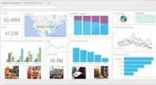
Elastic data warehouse as a service with enterprise-class features
Big Data Stores
Data Lake Store
Power BI
Hadoop
SQL Data
Warehouse
App Service
SQL Database
SQL Data Warehouse
Intelligent App
Machine Learning
Petabyte scale with massively parallel processing
Independent scaling of compute and storage—in seconds
Transact-SQL queries across relational and non-relational data
Full enterprise-class SQL Server experience
Works seamlessly with Power BI, Machine Learning, HDInsight, and Data Factory

Slide 16




Azure SQL Data Warehouse
Elastic scale & performance
End-to-end platform built for the cloud
Market leading price/ performance
Scales to petabytes of data with MPP processing
Resize compute nodes <1 minute
Faster time to insight than other SMP offerings
Designed for on-demand workload
Integrated with Azure platform and other Microsoft services
Enables hybrid solutions
Built on SQL Server experience & technology
Simple compute & storage billing
Pay for what you need
High performance without rewriting applications
Low cost for latent data
Infrastructure, management and support provided

Slide 17
Quick glance – Azure SQL Data Warehouse
Leverages cloud PaaS service
Massively parallel processing (MPP) to scale to PBs
In-memory columnstore for 100x speed improvement
PolyBase enables joining relational and Hadoop data
Only available in Azure as PaaS MPP DW

Slide 18
Azure SQL Data Warehouse Architecture
Application or User connection
Storage and Compute are de-coupled, enabling a true elastic service and separate charging for both compute and storage
DMS (Data Movement Service) executes across all database nodes
Data Loading
(SSIS, REST, OLE, ADO, ODBC, WebHDFS, AZCopy, PS)
Control
Node
DMS
Massively Parallel Processing (MPP) Engine
100 DWU < > 2000 DWU
Compute
Scale compute up or down when required
(SLA <= 60 seconds).
Pause, Resume, Stop, Start.
DMS
DMS
DMS
DMS
SQL DB
SQL DB
SQL DB
SQL DB
Compute
Node
Compute
Node
Compute
Node
Compute
Node
Azure Infrastructure and Storage
Blob storage [WASB(S)]
Storage
Add\Load data to WASB(S) without incurring compute costs
HDInsight

Slide 19
Azure SQL Data Warehouse – Control Node
SQL DB
SQL DB
Control
Node
Massively Parallel Processing (MPP) Engine
Control
Node
SQL DB
SQL DB
SQL DB
SQL DB
Compute
Node
Compute
Node
Compute
Node
Compute
Node
Endpoint for connections
Regular SQL endpoint (TCP 1433)
Persists no user data (metadata only)
Coordinates compute activity using MPP
Blob storage [WASB(S)]
HDInsight

Slide 20
Azure SQL Data Warehouse - Compute Nodes
SQL DB
SQL DB
Control
Node
Massively Parallel Processing (MPP) Engine
Compute
Node(s)
SQL DB
SQL DB
SQL DB
SQL DB
Compute
Node
Compute
Node
Compute
Node
Compute
Node
Azure SQL Database
An increase of DWU will increase the number of compute nodes
Blob storage [WASB(S)]
HDInsight

Slide 21
Azure SQL Data Warehouse – Blob storage
SQL DB
Control
Node
Massively Parallel Processing (MPP) Engine
SQL DB
SQL DB
SQL DB
SQL DB
RA-GRS storage
+PB’s of storage
Ingest data without incurring compute costs
Compute
Node
Compute
Node
Compute
Node
Compute
Node
Blob storage [WASB(S)]
HDInsight

Slide 22
Demo

Slide 23
Machine Learning and Analytics
Information Management
Big Data Stores
Machine Learning and Analytics
Data Sources
Data Lake Store
Machine Learning
Data Factory
SQL Data
Warehouse
Data Lake Analytics
Apps
Data Catalog
HDInsight
(Hadoop and Spark)
Event Hubs
Sensors and devices
Stream Analytics
Data
Intelligence

Slide 24
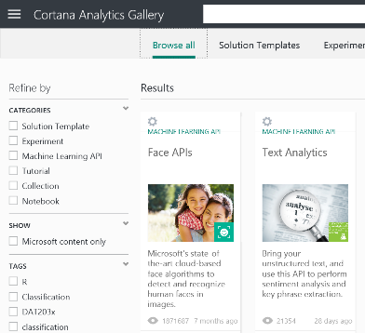
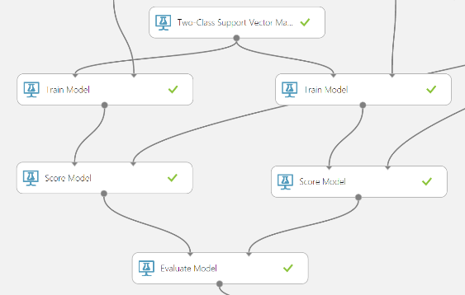
Easily build, deploy, and share predictive analytics solutions
Machine Learning and Analytics
Machine Learning
Data Lake Analytics
HDInsight
(Hadoop and Spark)
Stream Analytics
Simple, scalable, cutting edge. A fully managed cloud service that enables you to easily build, deploy, and share predictive analytics solutions.
Deploy in minutes. Azure Machine Learning means business. You can deploy your model into production as a web service that can be called from any device, anywhere and that can use any data source.
Publish, share, monetize. Share your solution with the world in the Gallery or on the Azure Marketplace.

Slide 25












Machine learning and predictive analytics
Machine learning and predictive analytics are core capabilities that are needed throughout businesses, education, and everyday life
Churn analysis
Social network analysis
Recommendation engines
Location-based tracking and services
Vision analytics
Weather forecasting for business planning
Legal discovery and document archiving
Equipment monitoring
Advertising analysis
Pricing analysis
Fraud detection
Personalized insurance

Slide 26
Machine learning overview
Machine learning often involves two primary techniques:
Supervised learning: Finding the mapping between inputs and outputs using correct values to “train” a model
Unsupervised learning: Finding patterns in the input data (similar to density estimates in statistics)
Data:
A B C D E F G H I J K L M N O P Q R S T U V W X Y Z
Rules, or algorithms:
about, Learning, language – Spelling and sounding builds words
Learning about language. – Words build sentences
Learning, or abstraction:
Any new understanding proceeds from previous knowledge.

Slide 27
Machine learning
Data:
A B C D E F G H I J K L M N O P Q R S T U V W X Y Z
Rules, or algorithms:
about, Learning, language – Spelling and sounding builds words
Learning about language. – Words build sentences
Learning, or abstraction:
Any new understanding proceeds from previous knowledge.
Learning/abstraction
Tree
Rules/algorithms
Data

Slide 28
Supervised learning
Purpose
Process: Data set and test set
Components
Computation and recommendations
Verification
Selection

Slide 29
Unsupervised learning
Purpose
Process
Components
Computation and recommendation

Slide 30
Azure Machine Learning
Why Azure Machine Learning?
Getting started
Setting up a Microsoft Azure account
Setting up a storage account
Setting up an Azure Machine Learning workspace
Advantages

Slide 32
Designing a solution using Azure Machine Learning
Load data set
1
Create experiment
2
Add transformations and filters
3
Create experiment path and apply algorithms
4
Save and run model
5
Publish model
6
Use model
7

Slide 33
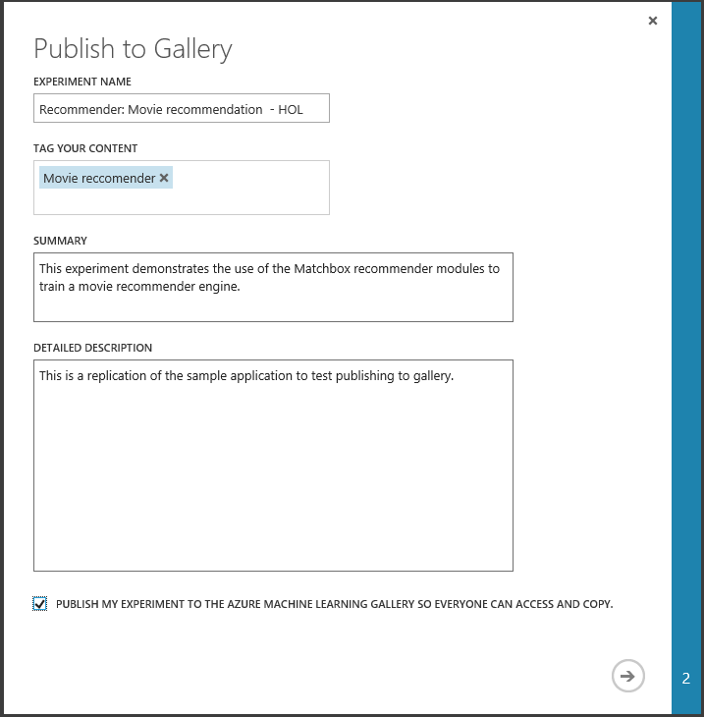
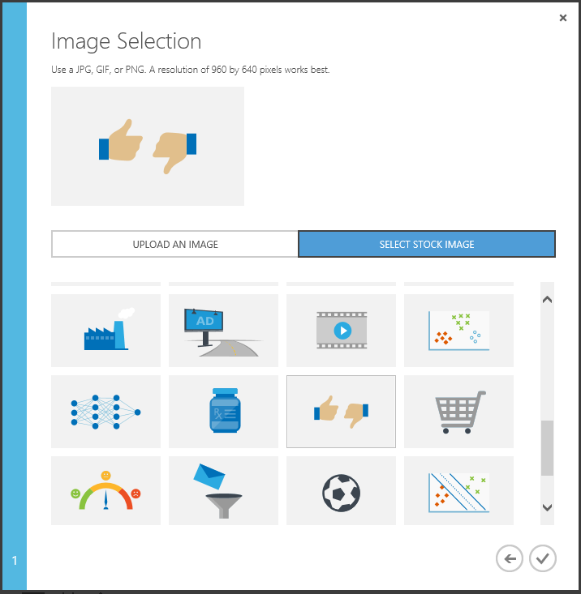
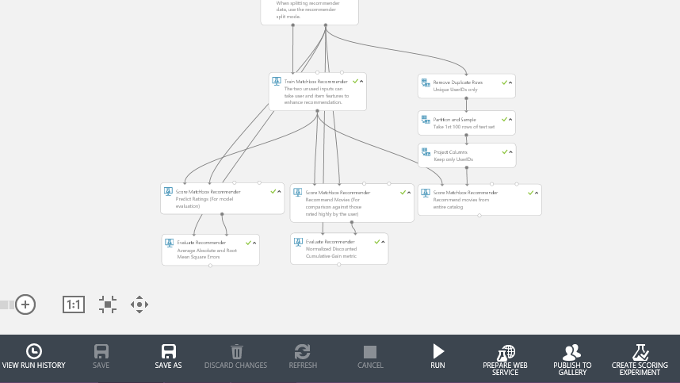
Publish to Gallery

Slide 34
Demo
Setting up Azure Machine Learning

Slide 35
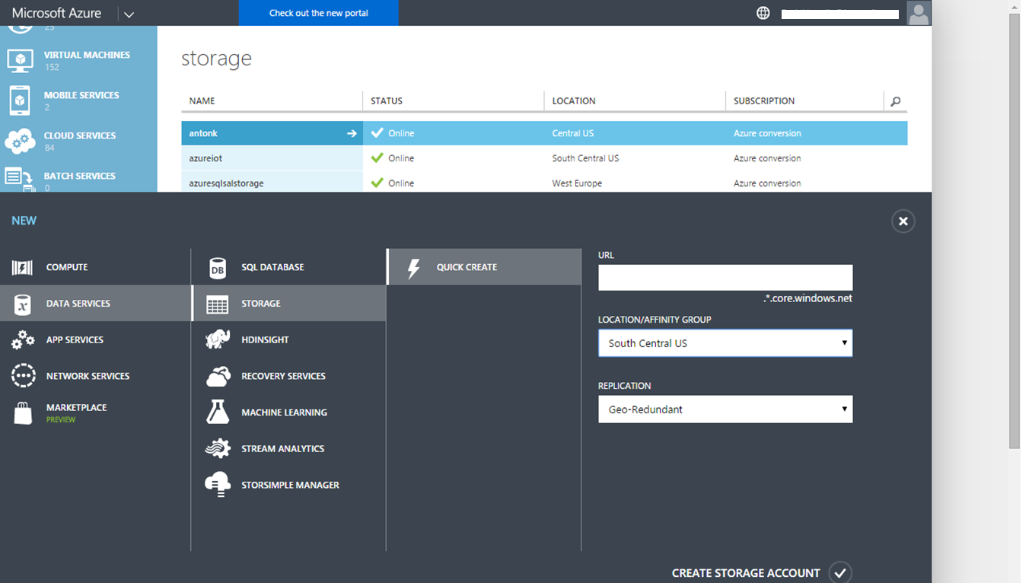

Slide 36
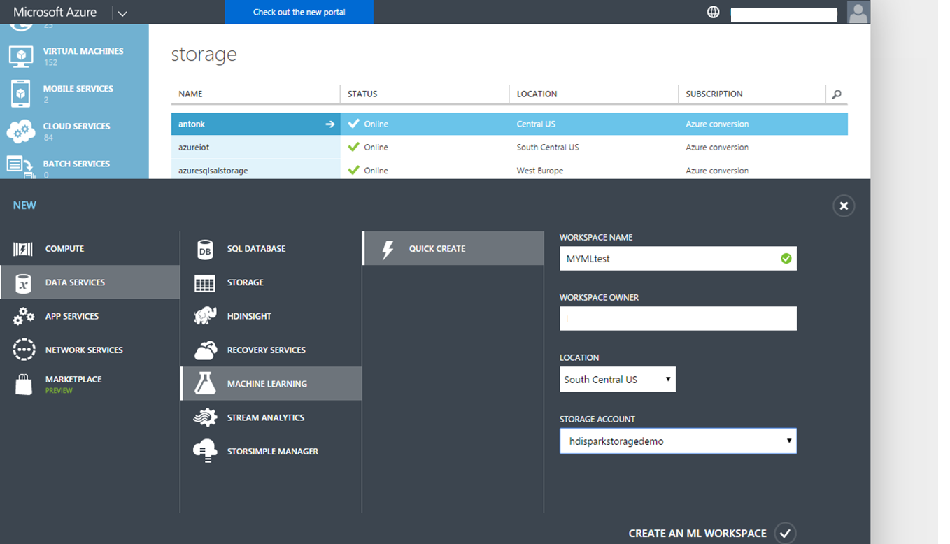

Slide 37
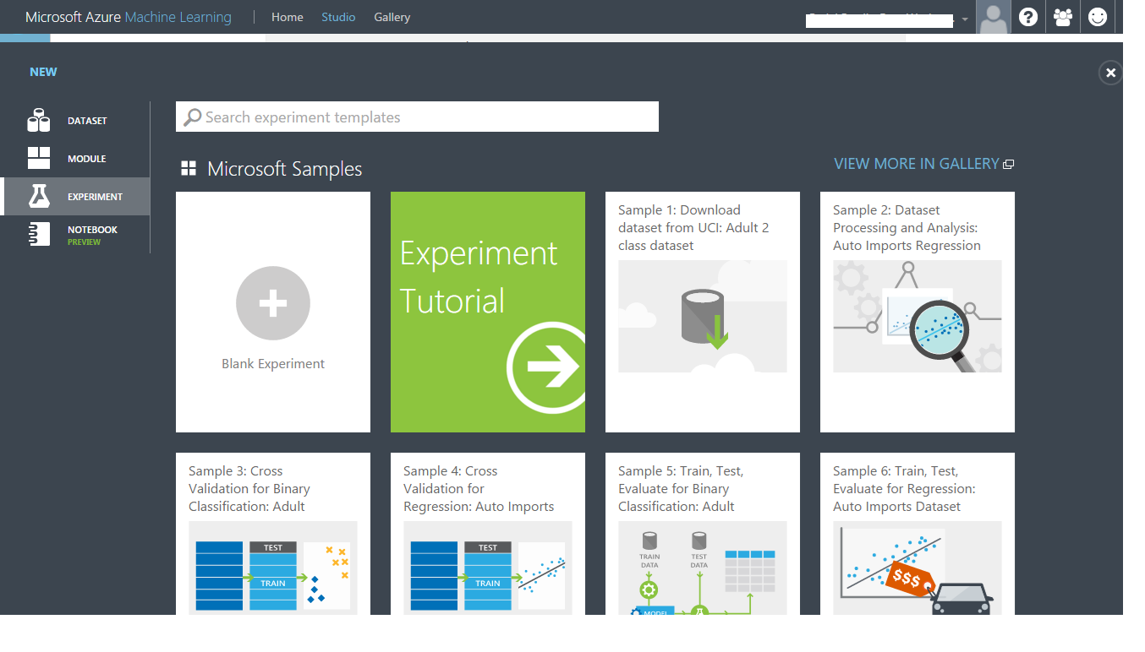

Slide 38
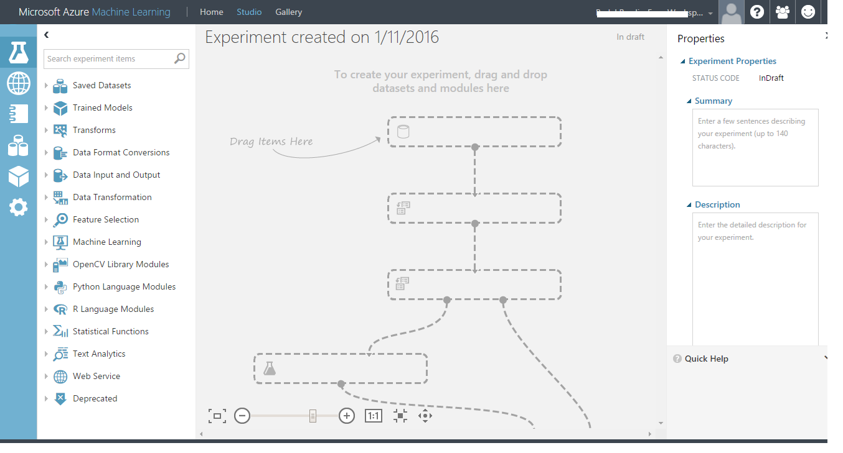

Slide 39
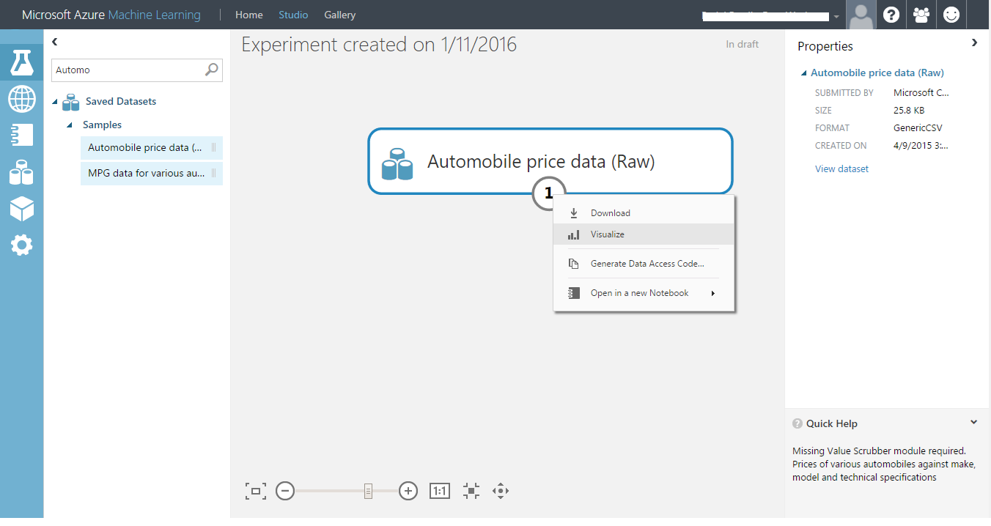

Slide 40
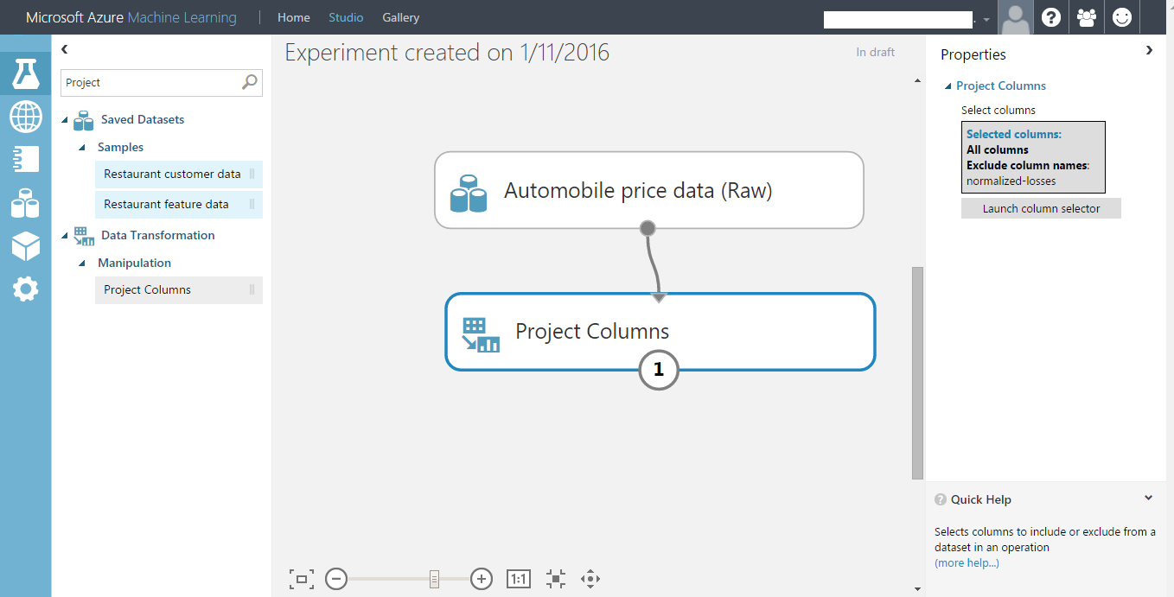

Slide 41
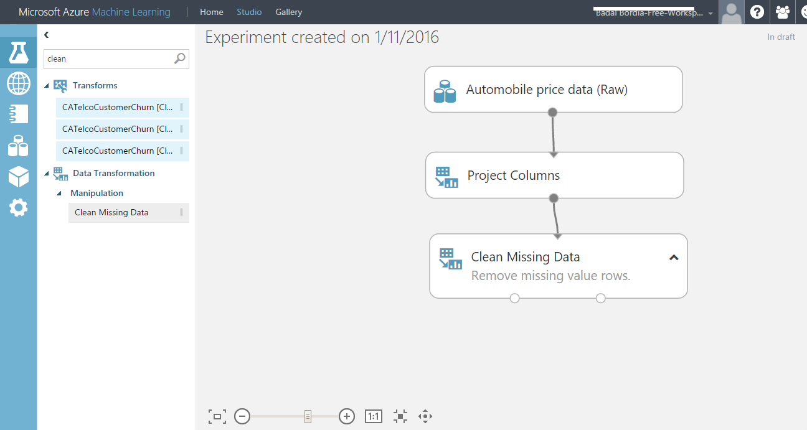

Slide 42
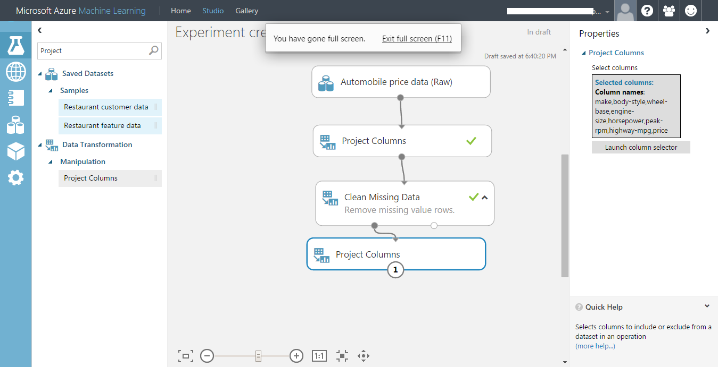

Slide 43
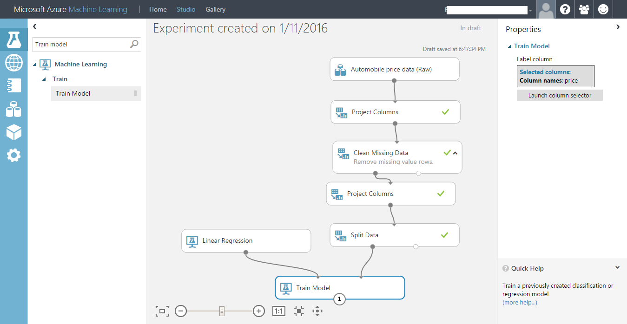

Slide 44
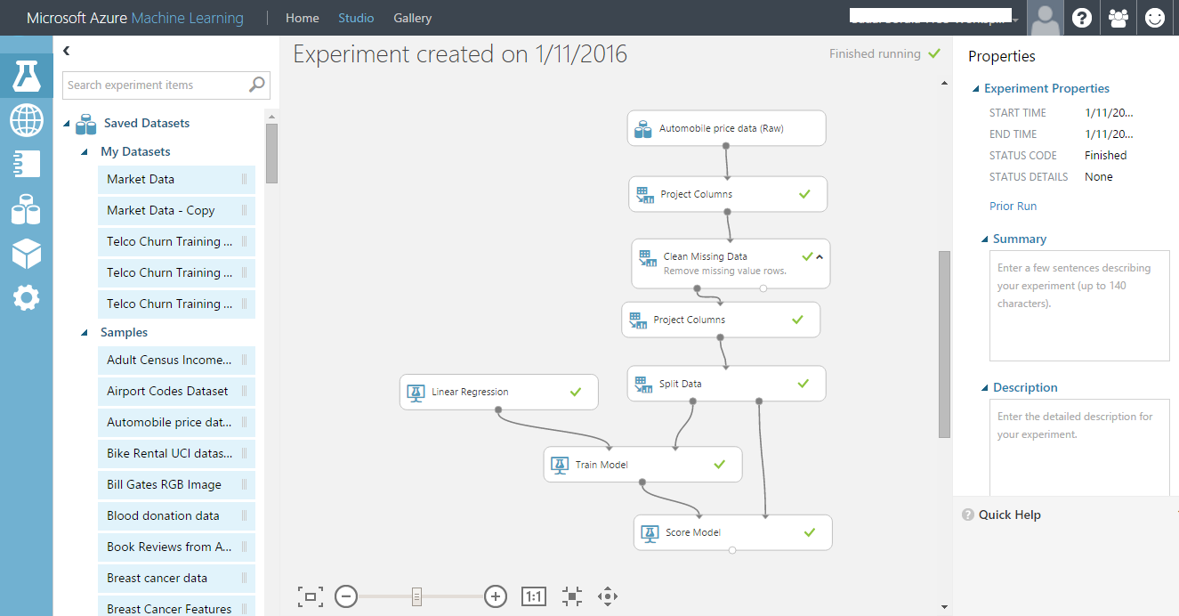

Slide 45
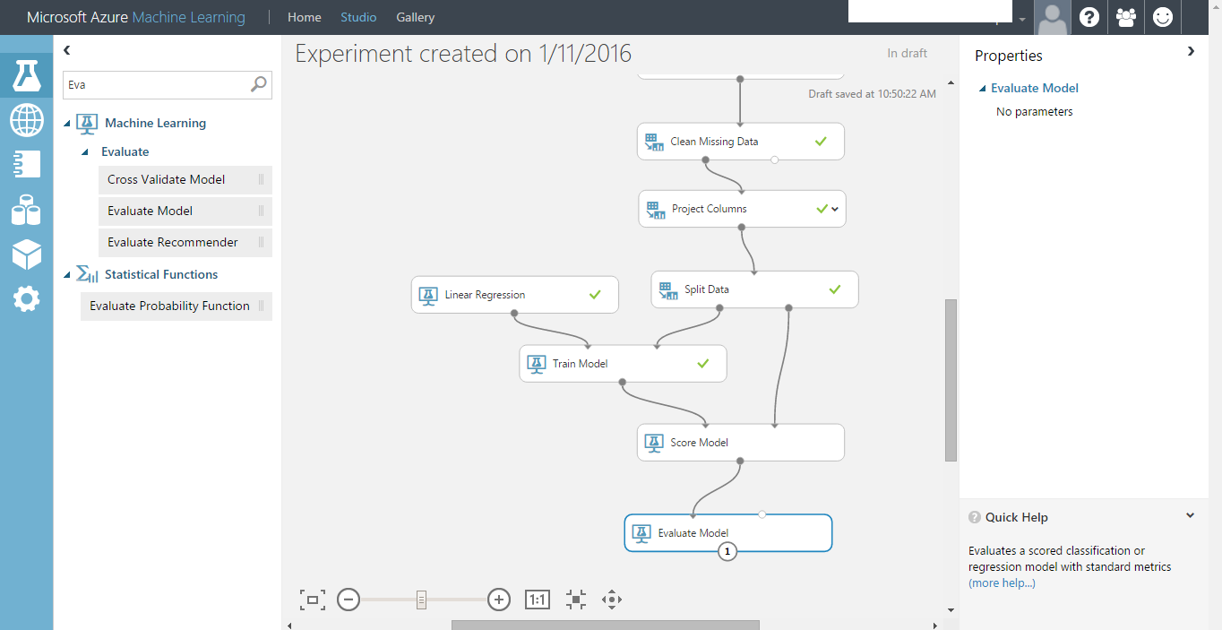

Slide 46
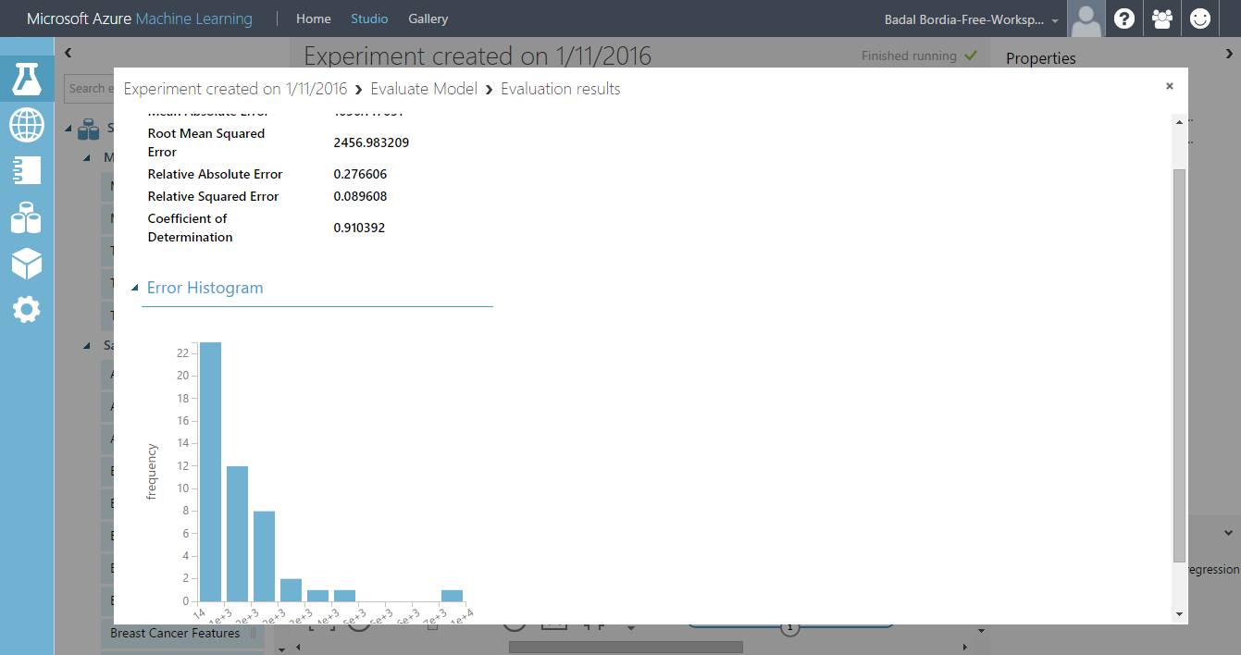

Slide 47
Demo
Deploying an API: Twitter sentiment analysis

Slide 48
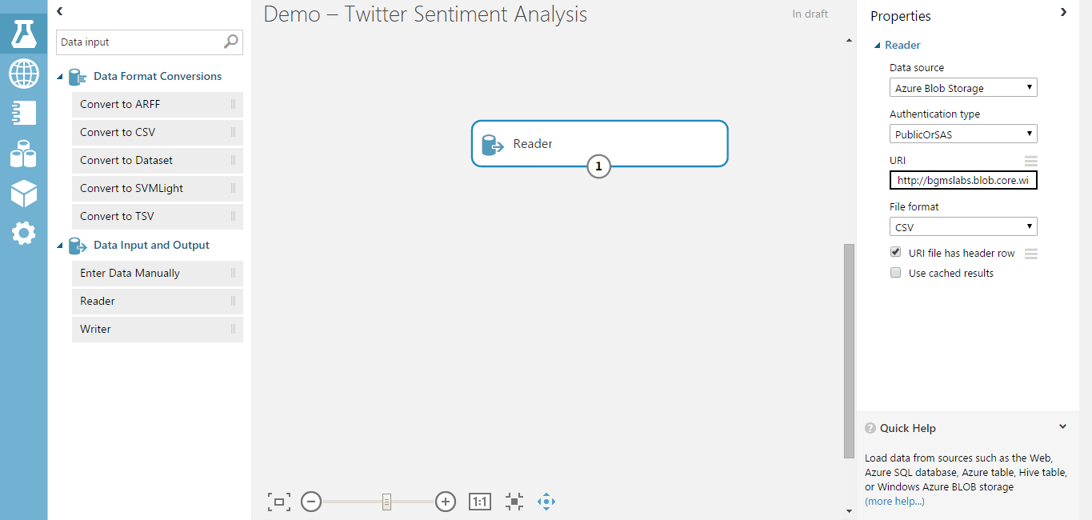

Slide 49
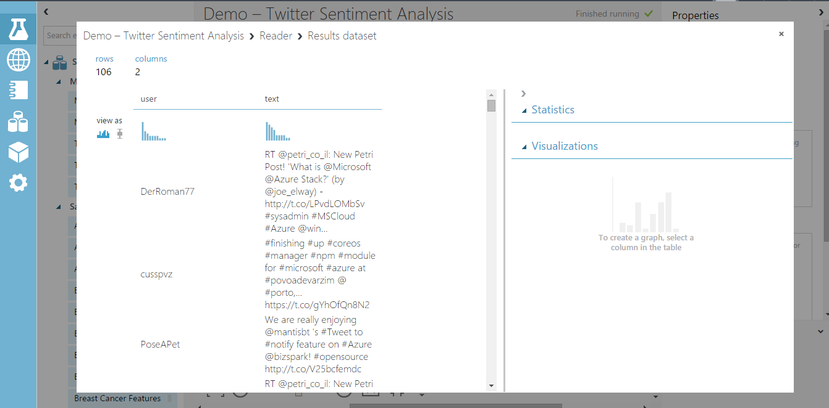

Slide 50
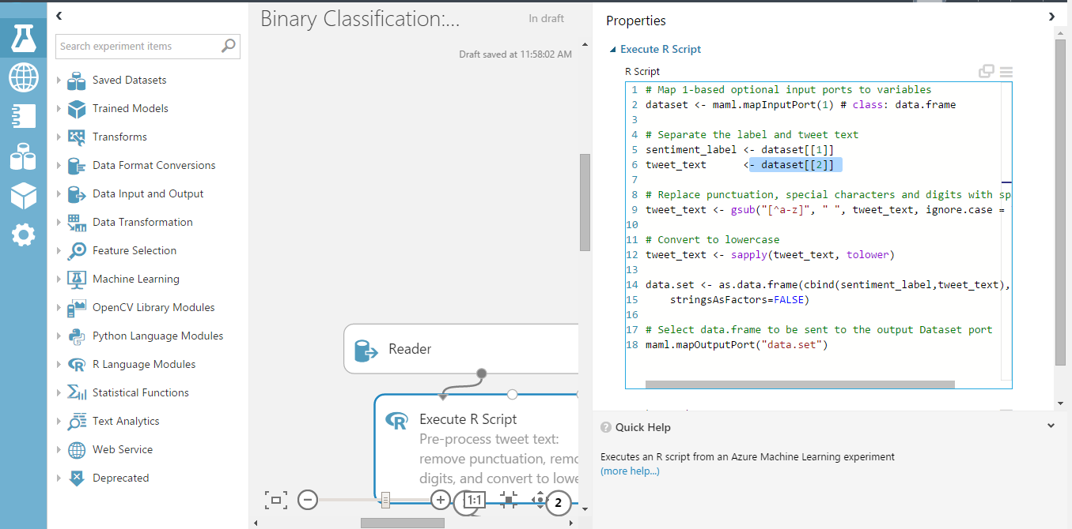

Slide 51
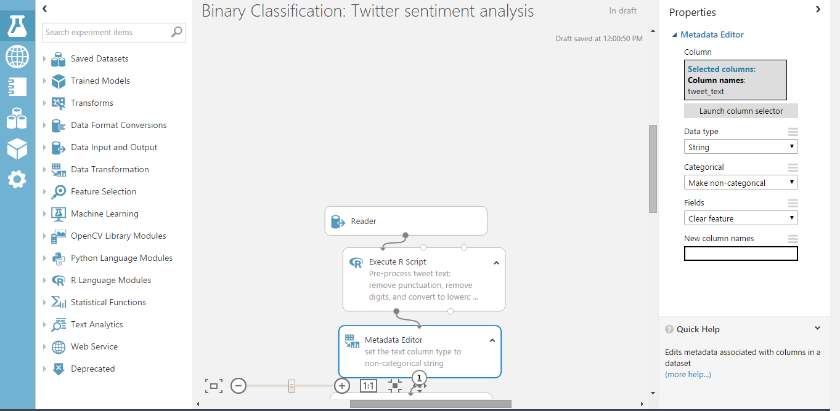

Slide 52
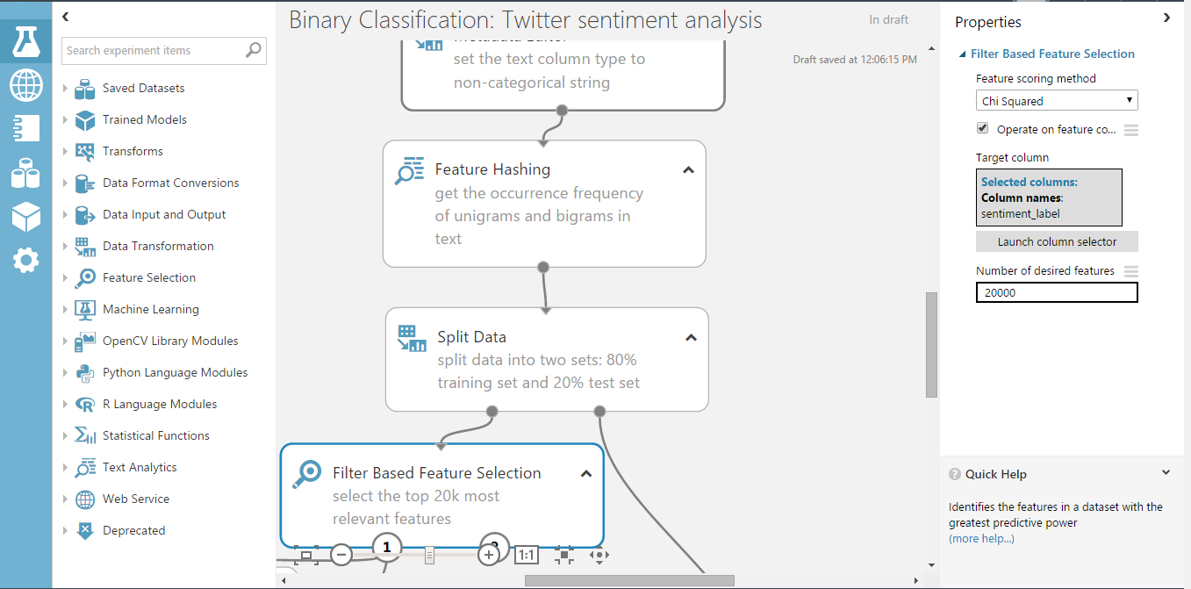

Slide 53
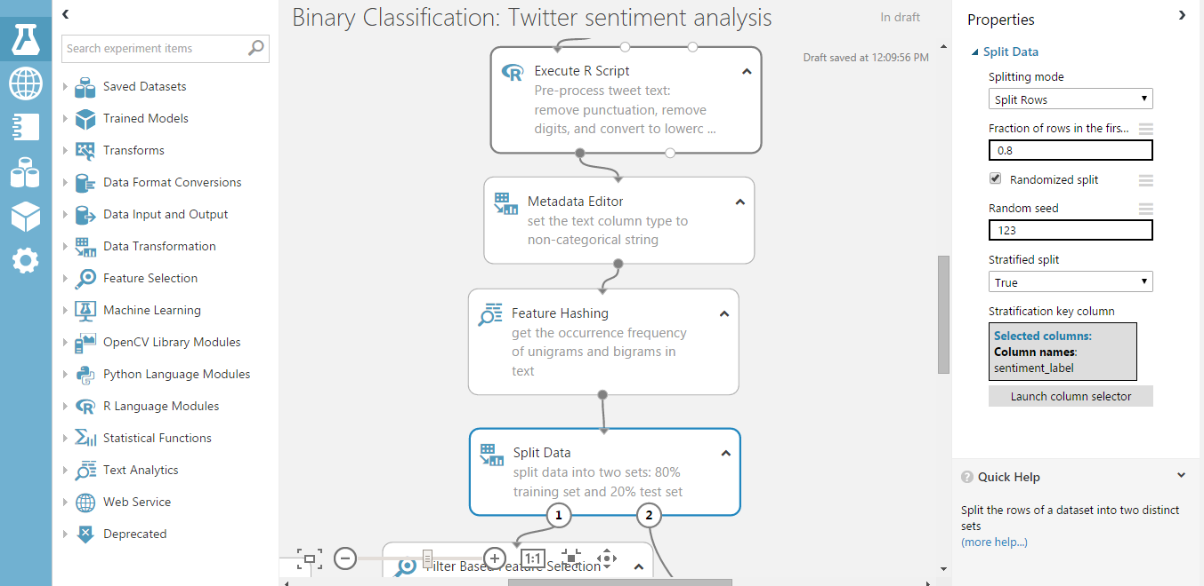
Train 80%
Test 20%

Slide 54
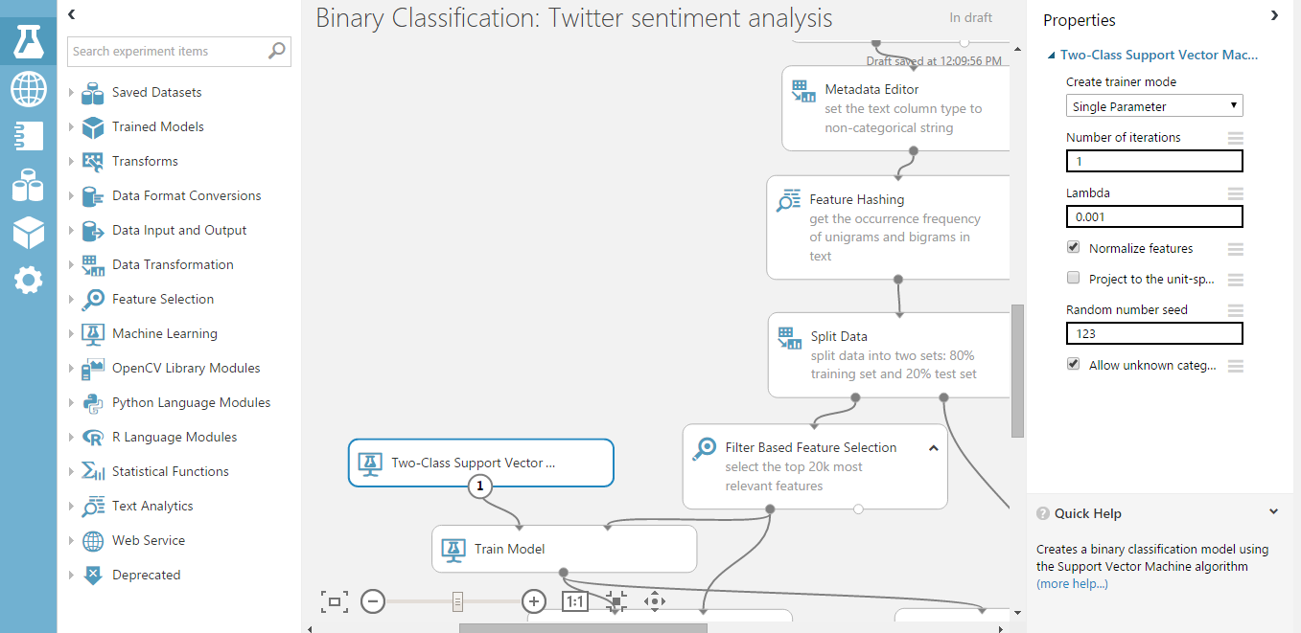

Slide 55
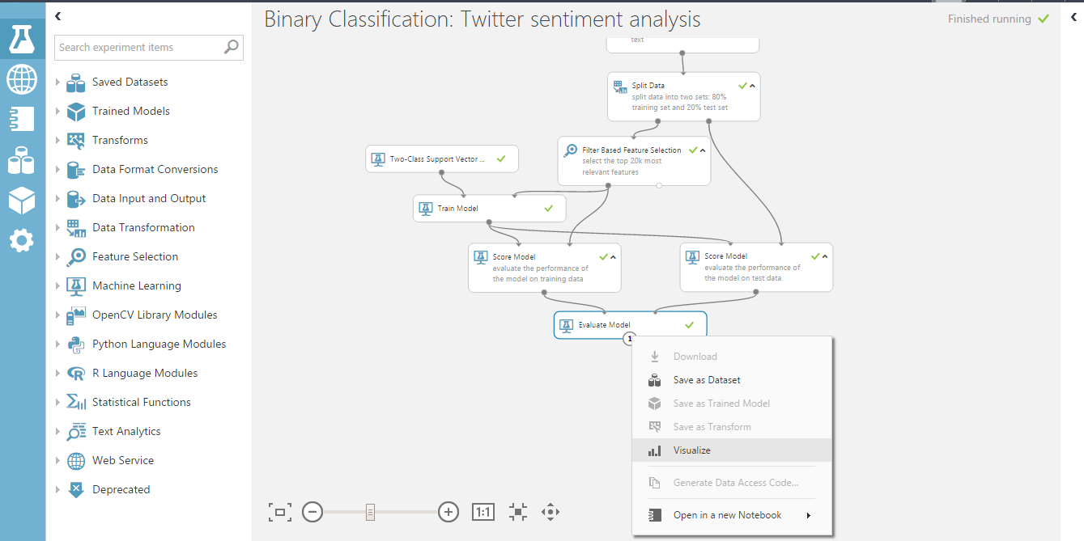

Slide 56
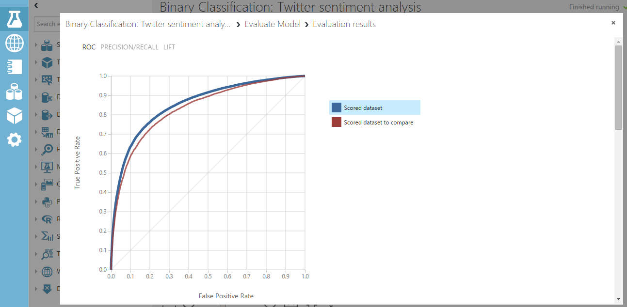

Slide 57
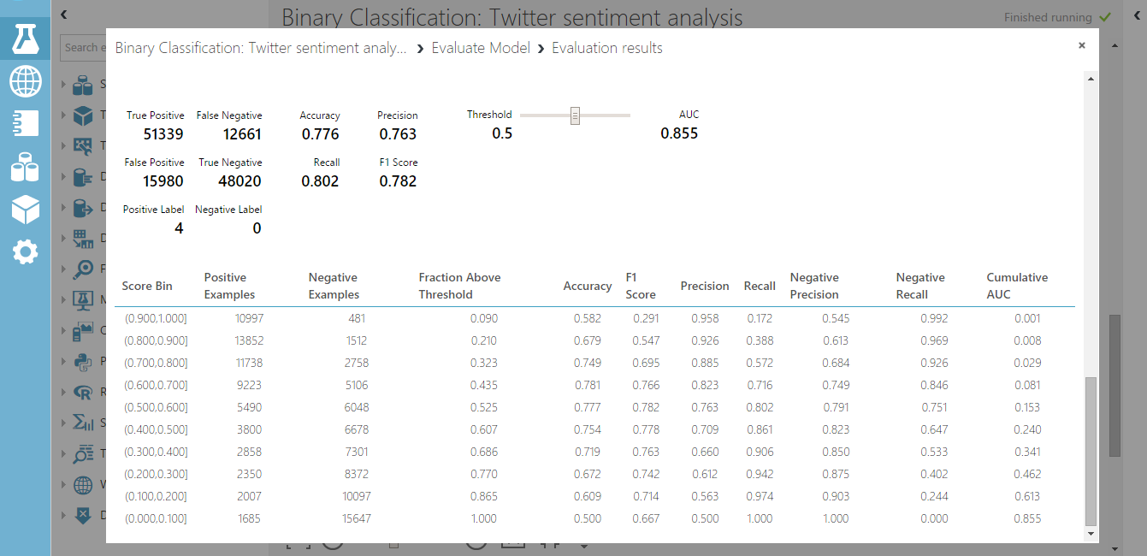

Slide 58
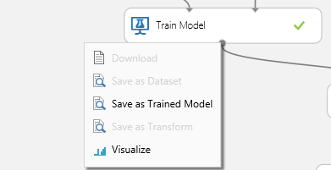

Slide 59
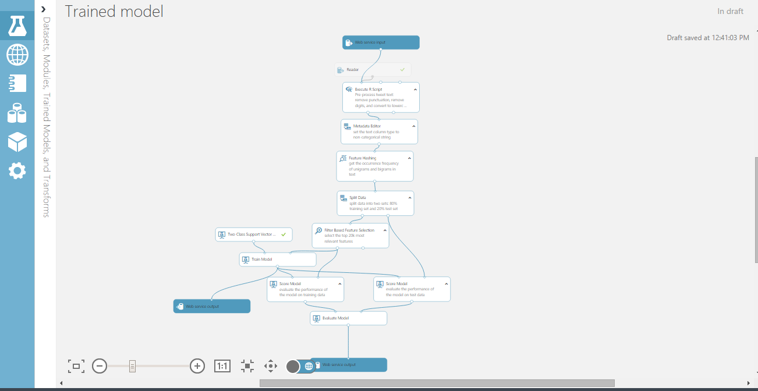

Slide 60
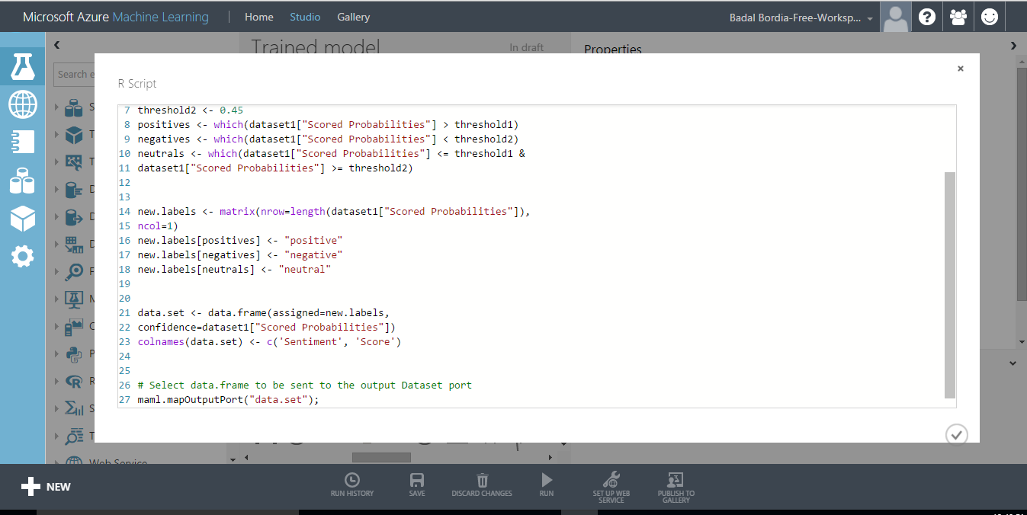

Slide 61
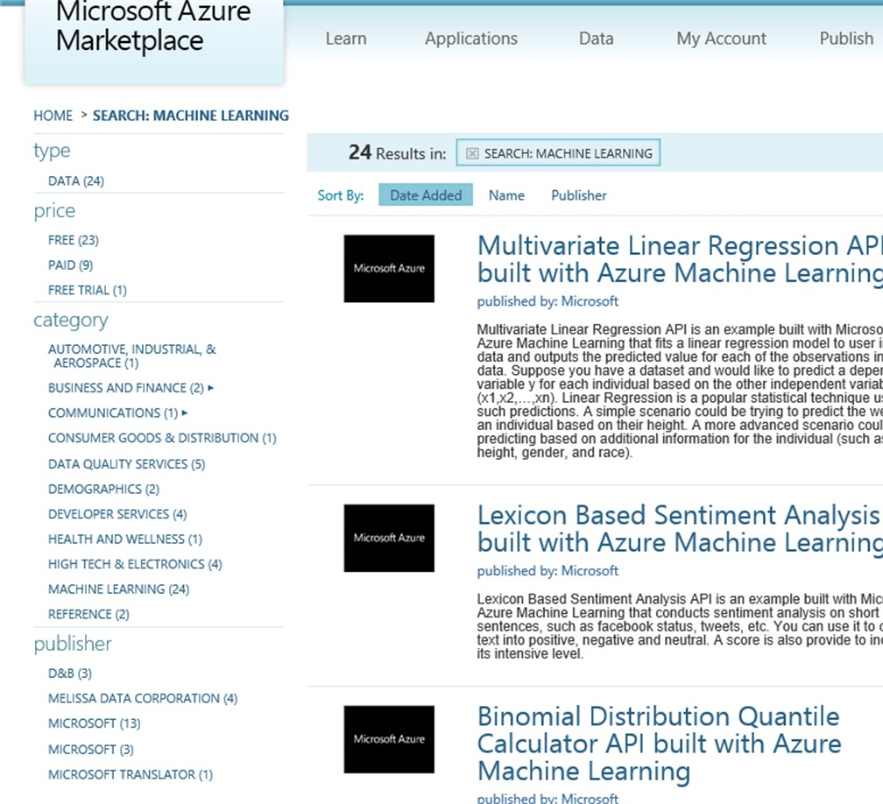
API examples
Difference in proportions test
Lexicon-based sentiment analysis
Forecasting – Exponential smoothing
Forecasting – ETS + STL
Forecasting – AutoRegressive Integrated Moving Average (ARIMA)
Normal distribution quantile calculator
Normal distribution probability calculator
Normal distribution generator
Binomial distribution probability calculator
Binomial distribution quantile calculator
Binomial distribution generator
Multivariate linear regression
Survival analysis
Binary classifier
Cluster model
And more on datamarket.azure.com

Slide 62
Demo

Slide 63
Q&A

Slide 64

© 2016 Microsoft Corporation. All rights reserved.

Slide 65
Appendix

